Slide 1
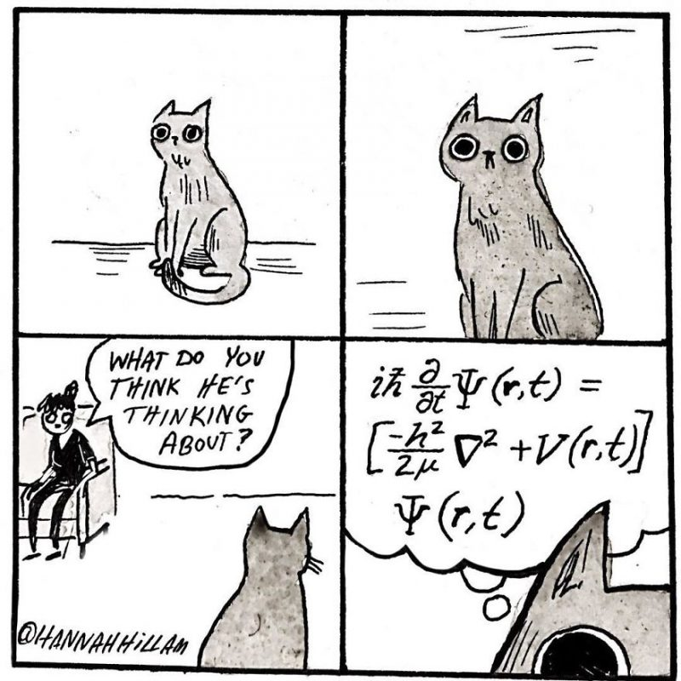

Fourier Analysis of Cats
Progress Report

Slide 2
Thesis
The goal behind this project is to understand what cat’s different sound waves look like according to mood.
Some analysis is to be done on a cat when they are happy and some is to be done when they are upset.
In the spectrum of an upset cat, there is still a pretty big difference between what the plots look like between two different moods.

Slide 3

Fourier Techniques on a Happy Cat
Here I used some techniques on my cat Bella when she was purring (happy).

Slide 4
Fourier Techniques on a Happy Cat
Here are the techniques used in the previous slide.
Input Commands | Output
>> [x,sr]=audioread('bellapurring.wav'); >> SoundWaveTimeFreq(x,sr,4.23,4.33,0,100) >> sr >> N=length(x) >> T=N/sr | sr = 44100 N = 580607 T = 13.1657

Slide 5
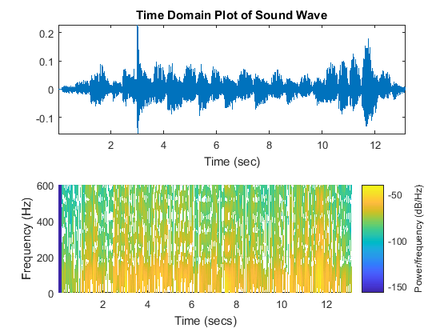
More Fourier Techniques on a Happy Cat
Here I used the SprectrogramPlot m-file to generate the following.
The frequencies
tend to be pretty
low for the most
part in this particular
soundwave.

Slide 6
More Fourier Techniques on a Happy Cat
The commands used were as follows.
Input Commands
>> [z,sr]=audioread('bellapurring.wav'); >> SpectrogramPlot(z,sr,600)

Slide 7
Fourier Techniques on a Meow
Here I used online resources to find a cat meowing. This was a lot harder to try to do in person with my sisters cat.

Slide 8
Fourier Techniques on a Meow
The commands used are as follows.
Input Commands | Output
>> [x,sr]=audioread('catmeow.wav'); >> SoundWaveTimeFreq(x,sr,0.5,0.6,0,1500) >> sr >> N=length(x) >> T=N/sr | sr = 11025 N = 8928 T = 0.8098

Slide 9
Fourier Techniques on a Meow
Another spectrogram plot this time of the meow.

Slide 10
Fourier Techniques on a Meow
The commands used for the spectrogram plot are as follows.
Input Commands
>> [z,sr]=audioread('catmeow.wav'); >> SpectrogramPlot(z,sr,1500)

Slide 11
Fourier Techniques on a Mad Cat
Here I used some techniques on a cat that was very upset. These results differ a lot from a cat that is just meowing.

Slide 12
Fourier Techniques on a Mad Cat
The commands used are as follows.
Input Commands | Output
>> [x,sr]=audioread('catmad.wav'); >> SoundWaveTimeFreq(x,sr,1.2,1.5,0,1800) >> sr >> N=length(x) >> T=N/sr | sr = 16000 N = 31728 T = 1.9830

Slide 13
Fourier Techniques on a Mad Cat
A spectrogram plot was created for the cat that was upset.

Slide 14
Fourier Techniques on a Mad Cat
Here are the commands used to generate the spectrogram plot of the mad cat.
Input Commands
>> [z,sr]=audioread('catmad.wav'); >> z=z(:,1); >> SpectrogramPlot(z,sr,1800)

Slide 15
Bandpassing of Soundwaves
Here I band passed my sister’s cat Bella when she was purring.

